Slide 1


ACCIDENTAL SWITCH ON/OFF PROTECTION USING DELAY
Prepared By: Kushang Darbar(18EC017)
Guide Name: Vishal Tank
V T Patel Department of Electronics and Communications
Chandubhai S Patel Institute of Technology

Slide 2
Flow of Presentation
Problems
Solutions
Block Diagram of project
Circuit Diagram of project
Working
Application
Timing Schedule and Cost of project
References

Slide 3
Problems
The accidental pressing of the on/off switch due to human error may cause the failure of the system it is connected to, or cause unnecessary delay to a part of the parent circuit.
This could, in turn, cost money and time to reset/reboot the system.

Slide 4
Solutions
The circuit presented in this requires you to keep the on/off switch pressed for a certain duration to make sure that the action is actually intended and not accidental.

Slide 5
Block Diagram
NE555 IC1
Astable multivibrator mode,
Gives clock pulses
CD4017B IC2 Decade counter
Gives visual feedback for how long should the switch be pressed to get the desired output
Relay connected get activated due to respective transistor
Desired Output

Slide 6
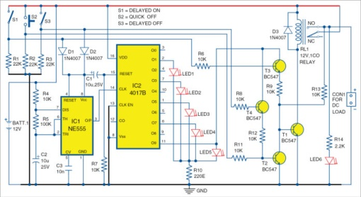
Circuit Diagram

Slide 7
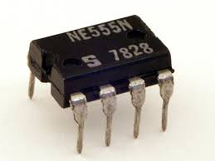
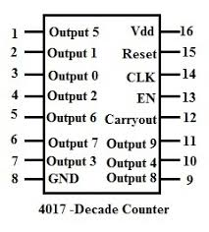
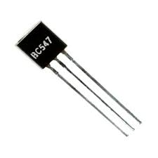
Components
NE555 timer (IC1): The 555 timer IC is an integrated circuit(chip) used in a variety of timer, pulse generation, and oscillator applications. The 555 can be used to provide time delays, as an oscillator, and as a flip-flop element.
Decade counter CD4017B (IC2): CD4017B are 4-stage Johnson counters having 8 decoded outputs. Inputs include a CLOCK, a RESET, and a CLOCK INHIBIT signal. Schmitt trigger action in the CLOCK input circuit provides pulse shaping that allows unlimited clock input pulse rise and fall times.
6 LED’s (LED1 through LED6)
4 npn transistors BC547 (T1 through T4)
12V Relay
Resistors
Diodes(1N4007)
Battery
Capacitors

Slide 8
Working
The circuit employs 555 timer IC, wired in astable-multivibrator mode, which serves as the clock source.
Decade counter IC CD4017 provides visual feedback on how long you should keep pressing the on/off switch to achieve the desired action.
12V DC load can be connected to relay output, which is controlled through switches S1 through S3.
Delay timing of IC1 is decided by timing components, namely, resistors R4 and R5, and capacitor C2.
LED1 through LED5 provide visual delay indication.

Slide 9
Continue….
On closing delay-on switch S1, transistor T3 conducts.
IC1 starts oscillating, IC2 starts counting and LED1 through LED5 glow one after another and when IC2 counts to Q9 (at pin 11), its output turns on T1, relay RL1 energises.
DC load connected across CON1 will be on after a prefix delay. Now, disconnect S1.
On pressing quick-off switch S2 momentarily, T2 and T1 conduct to switch off the load, as RL1 is de-energised.

Slide 10
Continue….
On closing delay-off switch S3, T4 conducts.
IC1 starts oscillating, IC2 starts counting and LED1 through LED5 glow one after another.
When IC2 counts at Q9 (at pin 11), its output turns on T2, RL1 de-energises to disconnect DC load after a prefixed delay.
Now, disconnect S3.

Slide 11
Applications
Used to protect the home appliances from voltage fluctuations by connecting a power guard in the circuit.
Even in the industries and other commercial purpose, this is used.
Used to protect the electronic device from unintentional switch on/off.

Slide 12
Time Schedule and Cost of project
Week 1: Definition and research
Week 2: Presentation preparation
Week 3: Implementation on Proteus
Week 4: Solving the problems occurred in the circuit
Week 5: Implementing it on bread-board
Approximate cost of the project-Rs750 to Rs800

Slide 13
References
https://electronicsforu.com/electronics-projects/accidental-switch-on-switch-off-protection-using-delay
https://electronicsforu.com/resources/learn-electronics/555-timer-working-specifications
https://www.elprocus.com/ic-4017-pin-configuration-application/
Electronics for You – vol. 1

